Slide 1
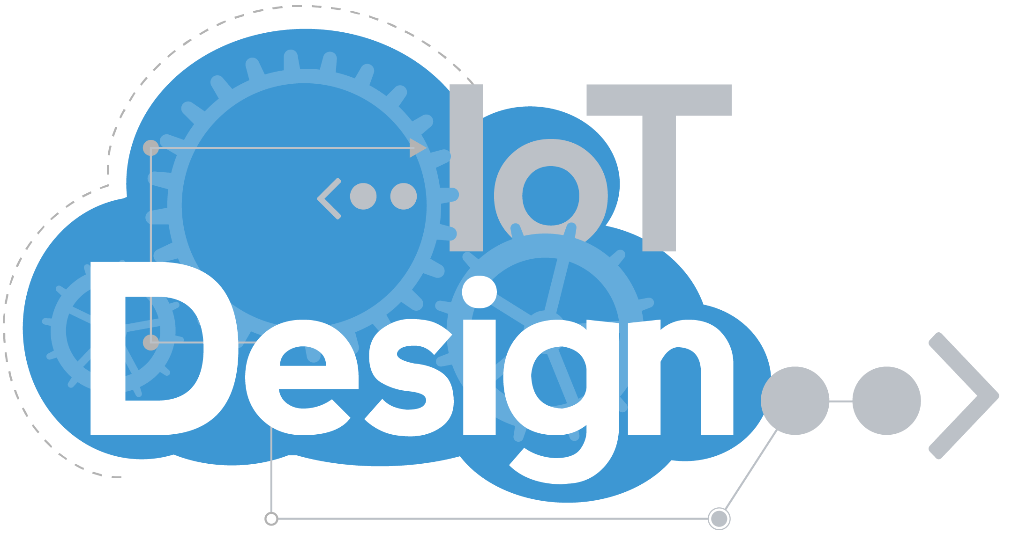
Project 3 – Smart Home
By Zhong Zheng

Slide 2
Features
Have a LED and push button to control LED
Collect light and temperature (in degree Fahrenheit) data in your home and store them in cloud
Use mobile phone
To remotely view home data
To remotely control home light (LED)
Buzzer and light warning when Temperature is too high
Light Controlled by ThingSpeak TimeControl
ThingHTTP/Twilio/React/Channel field 2 will work together to send SMS message to phone if temperature is too high

Slide 3
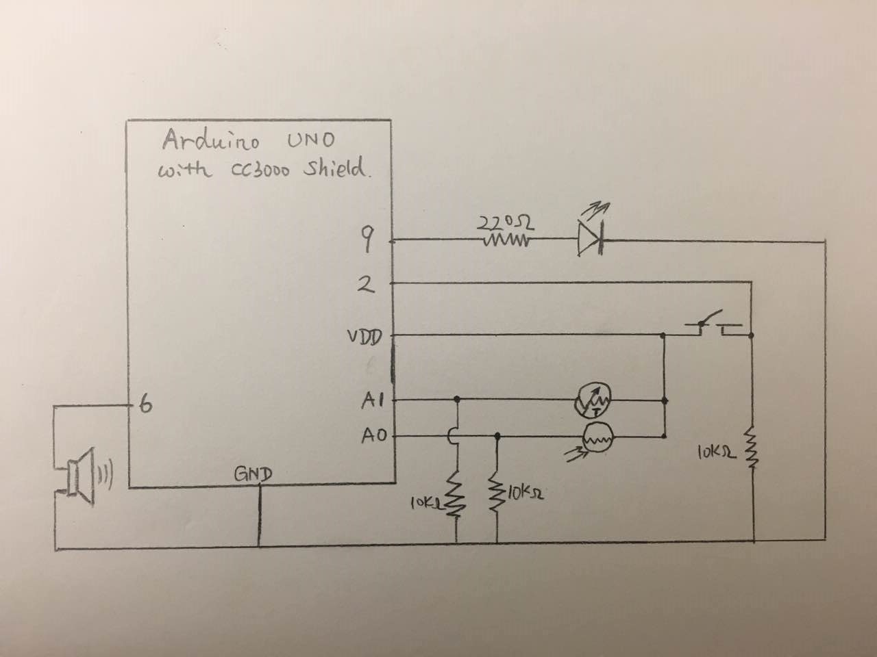
hardware design
The components:
1 Arduino UNO board
1 Adafruit HUZZAH cc3000 shield
1 yellow LED
1 Pushbutton switch
1 Temperature sensor
1 Light sensor
1 Piezo buzzer
3 10k ohm resistors and 1 220 ohm resistors
PIN usage:
Pin 9: output for LED anode
Pin 6: Piezo buzzer output
Pin 2: pushbutton control (interrupt)
Pin A0: Light sensor value input
Pin A1: Temperature sensor value input
Adafruit wifi shield connection:
SCK-PIN13 / MISO-PIN12 / MOSI-PIN11
CS-PIN10 / VBAT EN-PIN5 / INT-PIN3 / GND / 5V

Slide 4
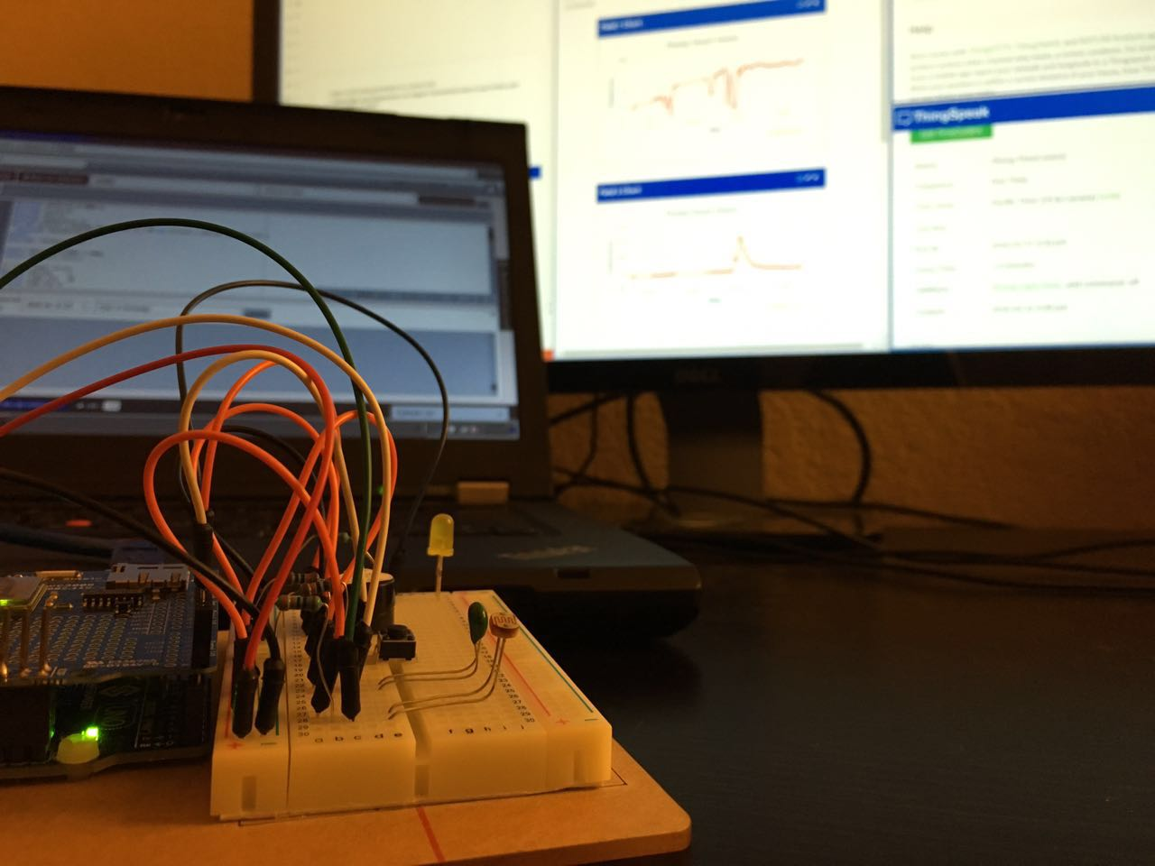
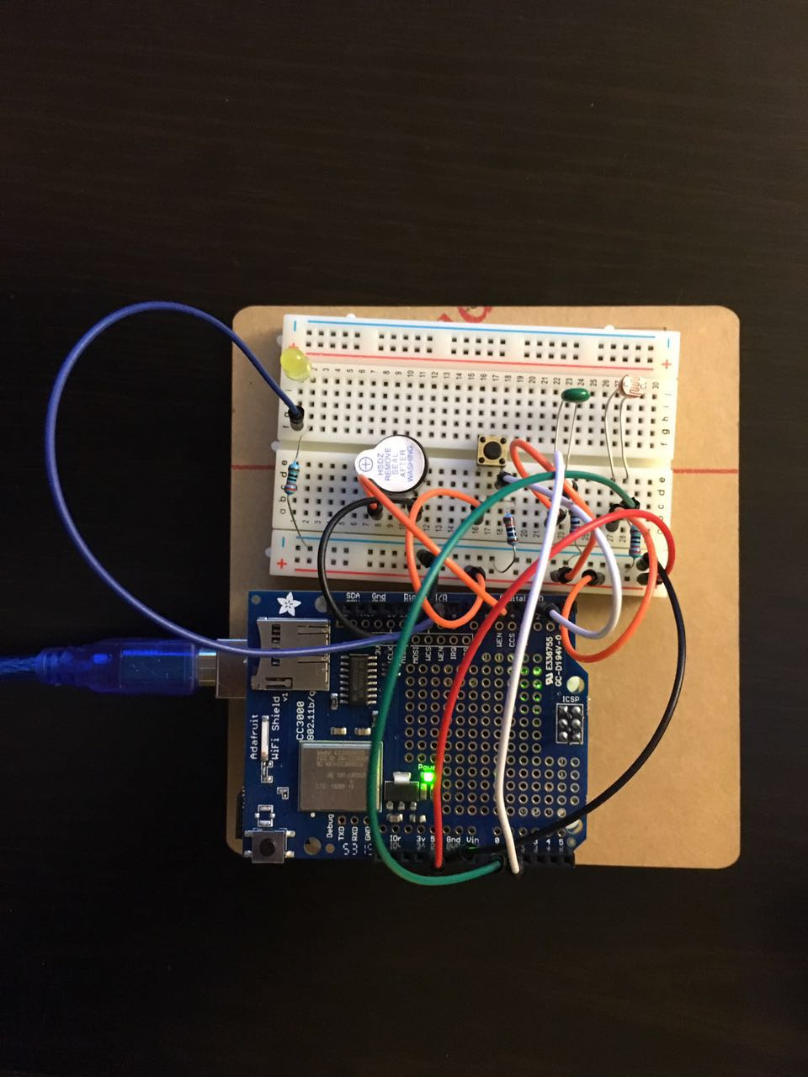
hardware design

Slide 5
void setup(void) { PIN setting interrupt setting wifi_init(); ThingSpeak.init(); } void loop(void) { light and temperature value sample ThingSpeak Talkback commandExecute(); Temperature > 100 yellow light and buzzer alarm system LED state update ThingSpeak channel initial and field update Serial.print light, temperature and ledState value } void button_Switch_Pushed() //PIN2 interrupt push button for switch double Thermister(int RawADC) // Turn sensor value to degree Fahrenheit
System / Software Design

Slide 6
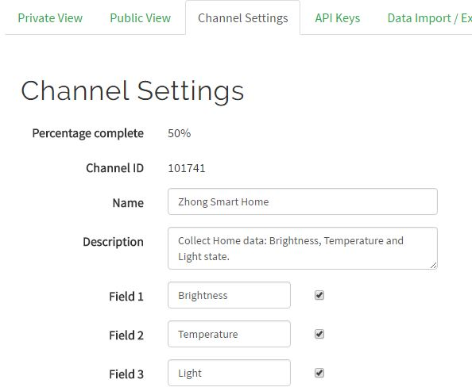
My Channel

Slide 7
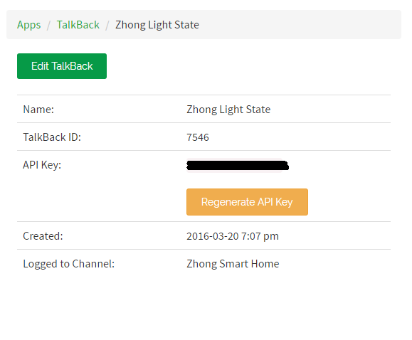
TalkBack

Slide 8
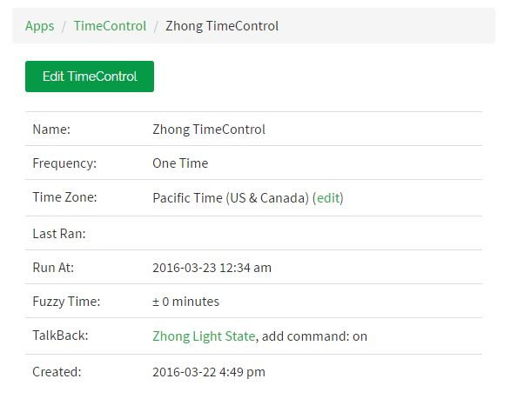
TimeControl

Slide 9
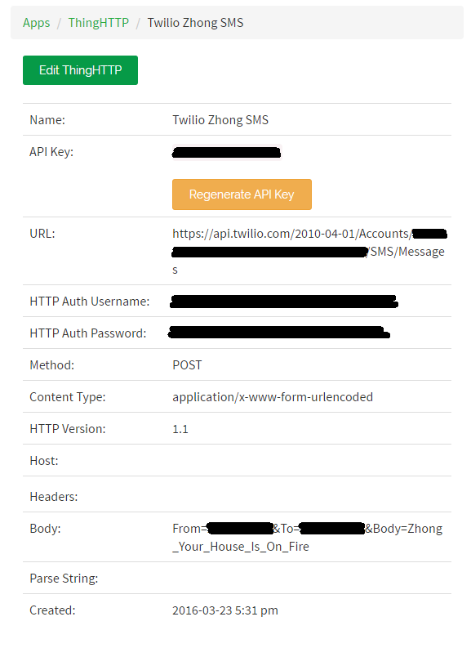
ThingHTTP

Slide 10
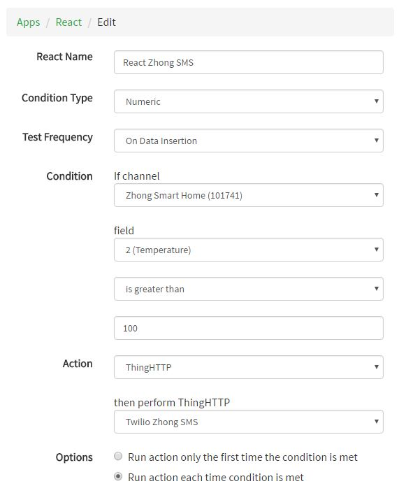
App React

Slide 11
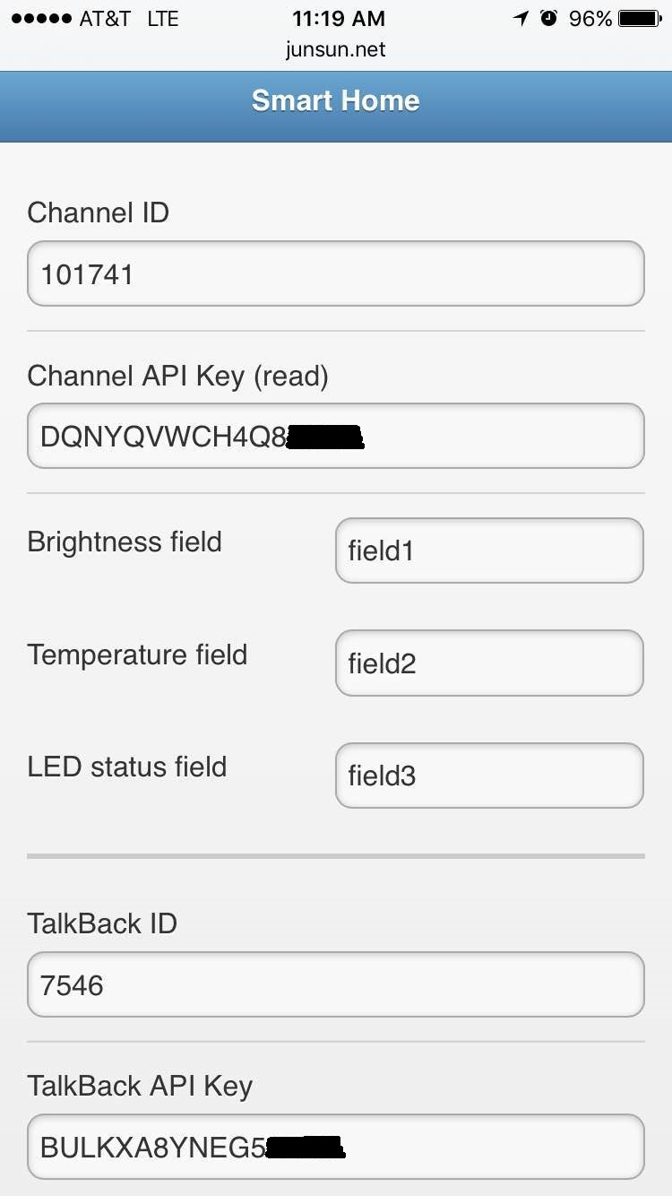
HTML5 App setup

Slide 12
Results
Sketch URL
https://codebender.cc/sketch:270068
Excerpts
08-01 ThingSpeak channel update(new) by Julian_sun
08-02 ThingSpeak command (new) by Julian_sun
Function double Thermister(int RawADC) from Arduino forum
Video clips of hardware setup and running
http://youtu.be/pf5iO8G4PSw
Console output excerpts : see attachment

Slide 13

YouTube Video
http://youtu.be/pf5iO8G4PSw

Slide 14
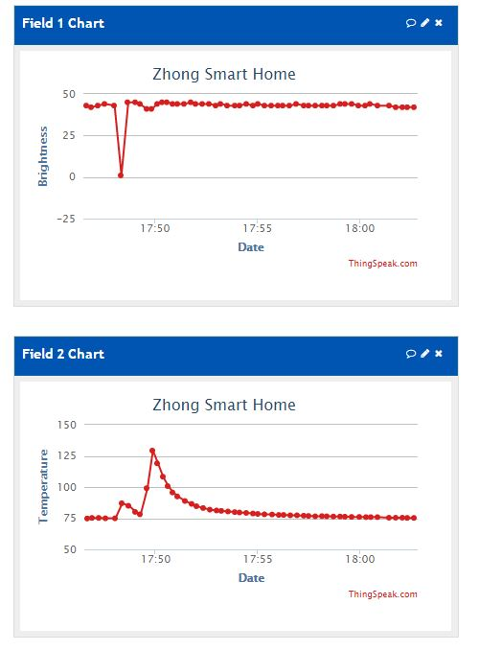
Results
ThingSpeak Channel Value

Slide 15
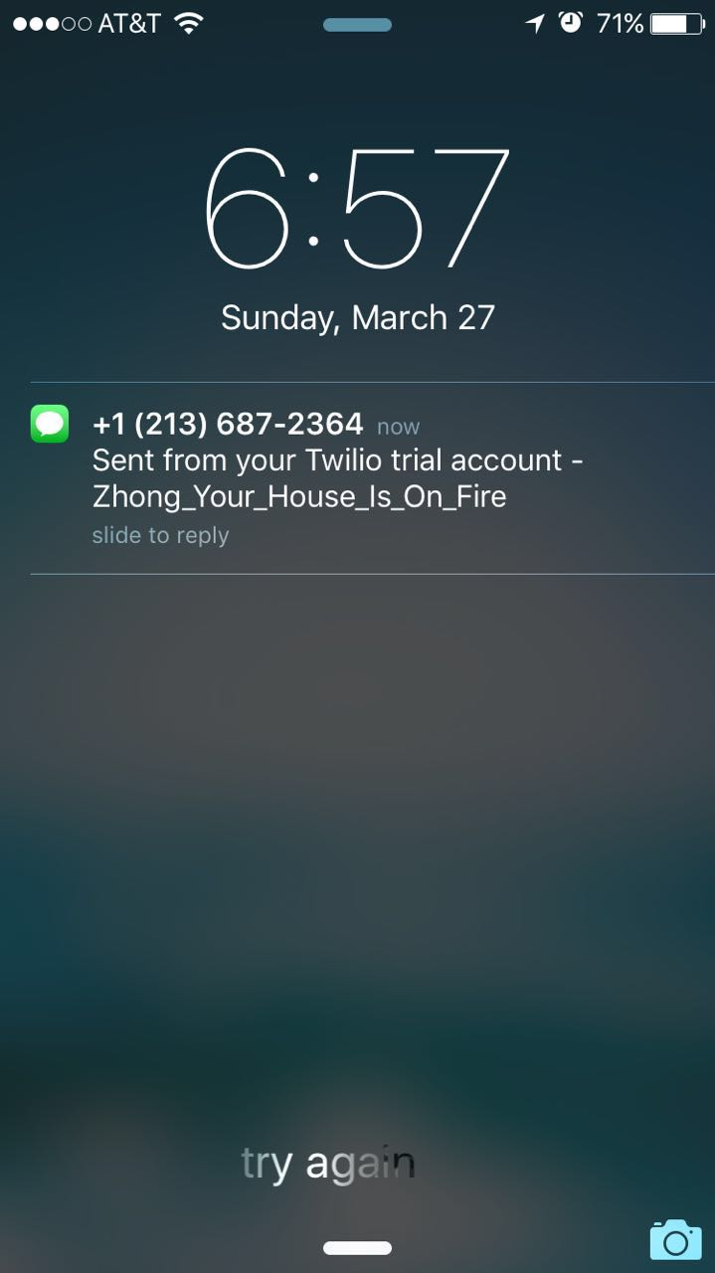
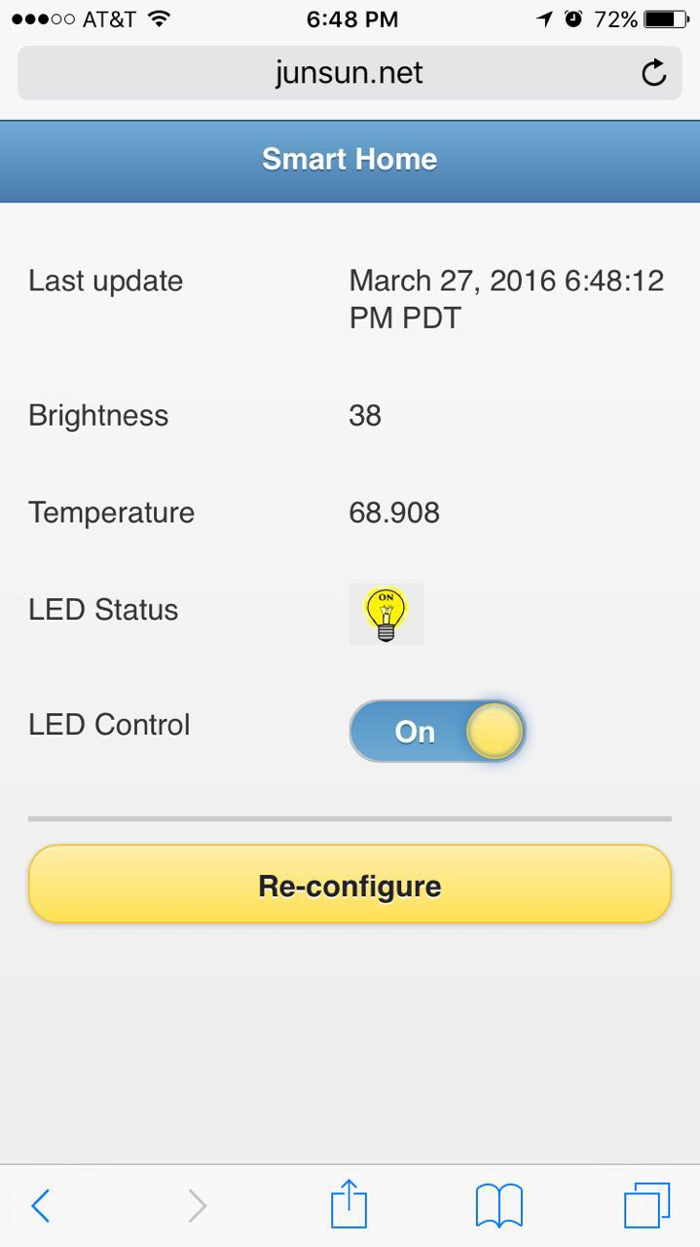
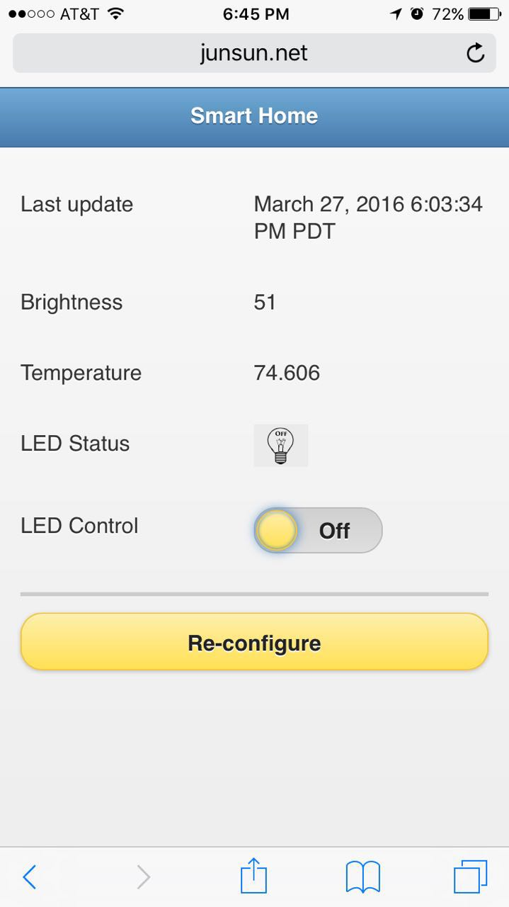
Results
Phone
SMS & App

Slide 16

IoT
Chip

Slide 17

生活不止眼前的苟且 还有诗和远方 Life is more than mess and struggle in front, as well as poetry and future.
Thank you

